Slide 1
Project on E-commerce Web App
Presented By- Deepmala Gupta
Guided By- Vikash Verma

Slide 2
E-Shop is a web application that is designed to allow customers to buy products online.
Customers can select, reserve, and purchase a product.
It offers a wide range of products with best-in-class quality and possibly at the cheapest price available.
On-time delivery.

Slide 3
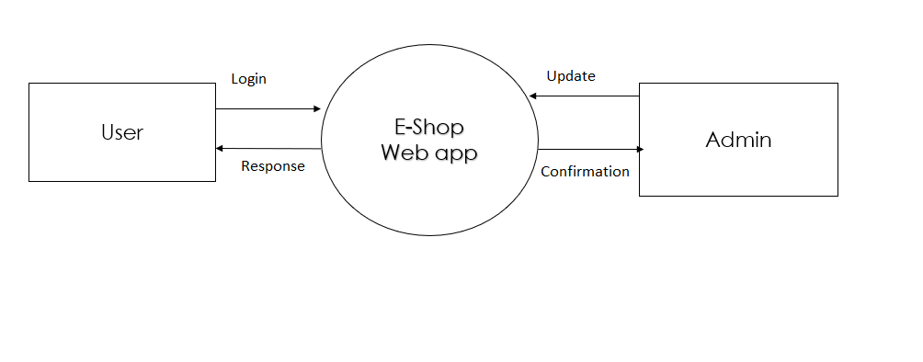
Data Flow Diagram

Slide 4
Implementation
For frontend I used visual studio code as a platform and a project made on angular.
Visual studio for creating web API and implementation of controllers and models it is intermediate of frontend and database.
SQL server is used for the database to store data.
Implementation of components for login authentication.
Database(Microsoft SQL Server Management Studio)
WebAPI(Visual Studio 2019)
Frontend(Visual studio code)

Slide 5
Features
User can register and login
Guest users can see the products but can not buy it.
Registered users can add products to the cart.
Wide range of collection
Super fast check out
Cache on delivery Available

Slide 6
IdppppP Password
Tables
Product Table
ID | Product Name | Product Description | CatID | Product image | ProductMRP | ProductDiscpount | ProductFinal | ProductQuantity
2. Category Table
Id | CatName
3. Login Table
Id | UserName | Password | IsAdmin

Slide 7
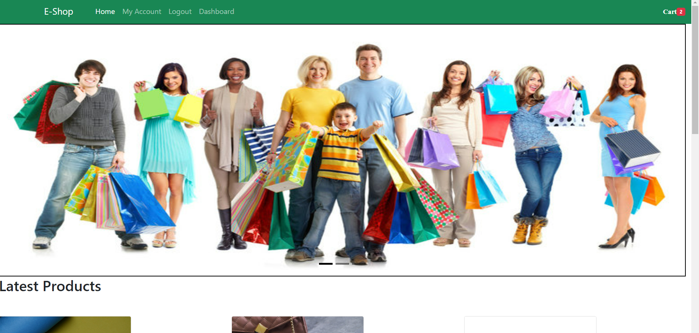
Home page

Slide 8
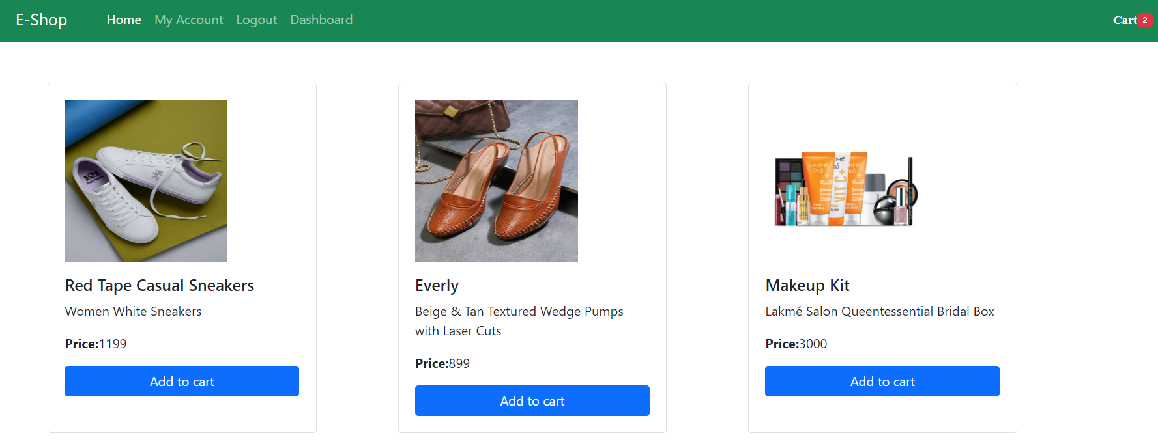
Product Page

Slide 9
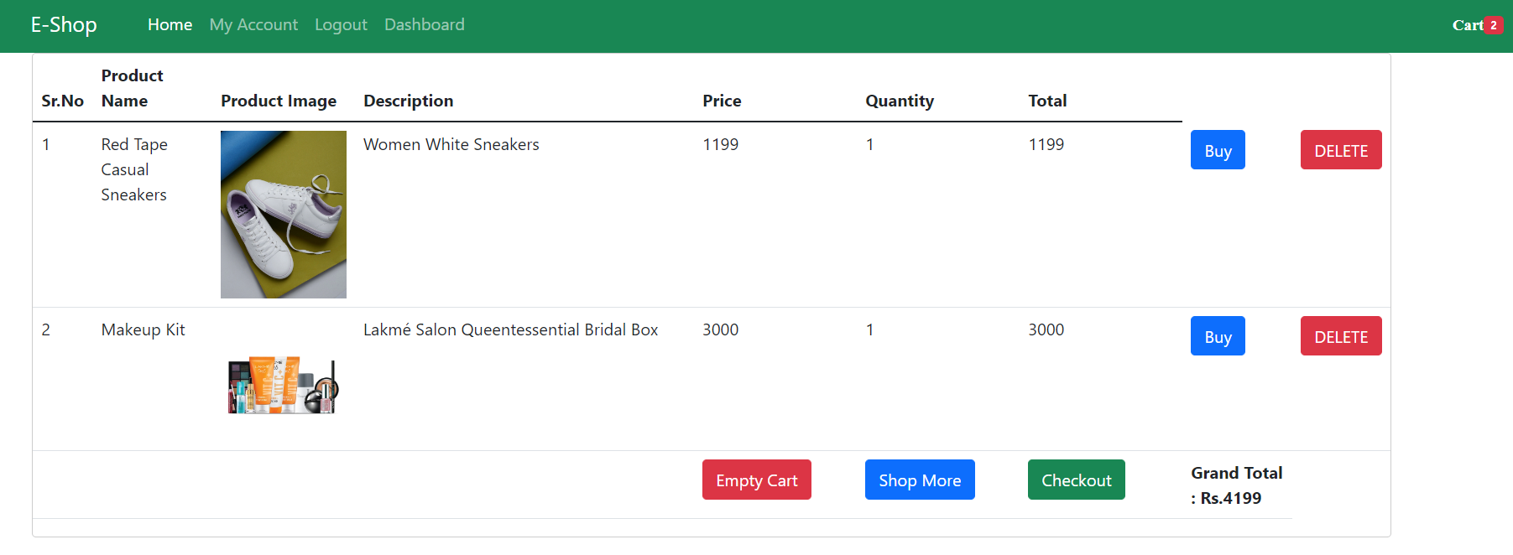
Add to Cart

Slide 10
Thank You

